Slide 1
Alexander Chang
Booze Happiness& Trump
NURS 741| Big Data Analytics

Slide 2

Background
This is a fun analysis that seeks to fulfill two goals:
Answer if a country’s happiness score & alcohol consumption affects their net approval of Trump
Serve as practice for R’s data visualization tools
More Booze = Happier?
Which type of Booze produces most happiness?
Why do we see these trends?

Slide 3

The Data Sources
World Health Organization, Global Information System on Alcohol and Health (GISAH), 2010
Sustainable Development Solutions Network, World Happiness Report 2015.
Pew Research Center, World Trust of Trump 2017

Slide 4

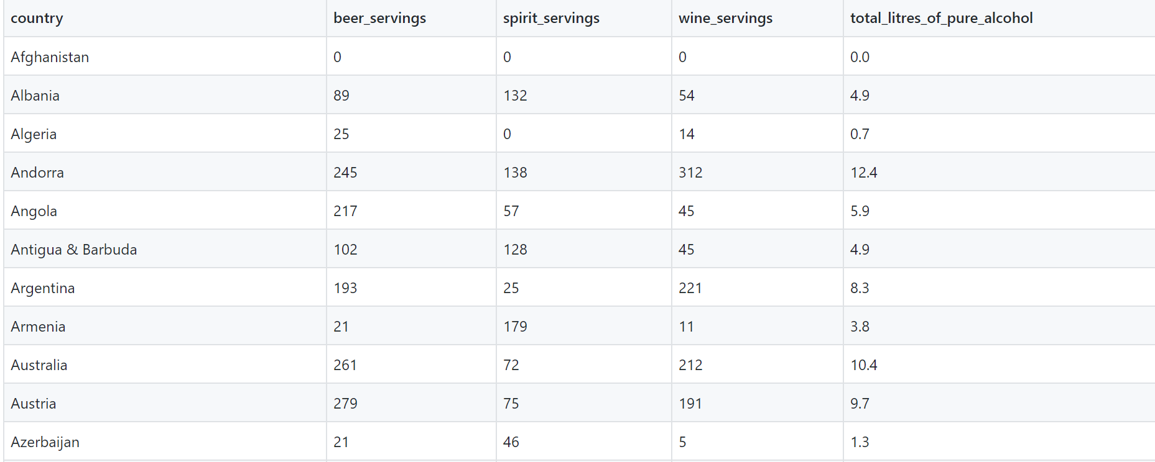
World Health Organization, Global Information System on Alcohol and Health (GISAH), 2010

Slide 5
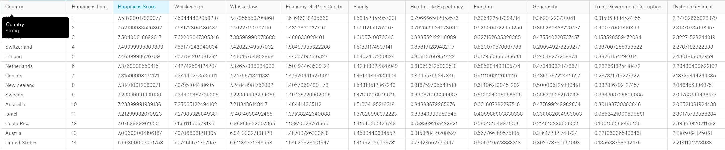
Sustainable Development Solutions Network, World Happiness Report 2015.

Slide 6
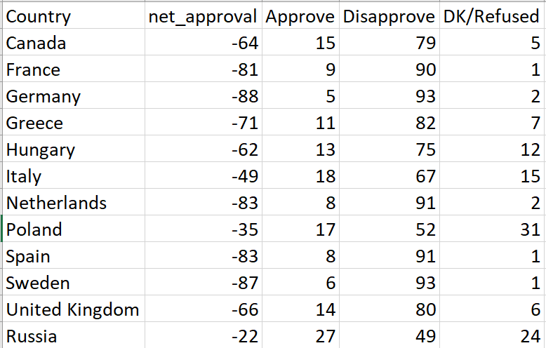
Pew Research Center, World Trust of Trump 2017

Slide 7
Analysis – Booze vs Happiness
Happiness Score ~ Beer Servings = 0.51
Happiness Score ~ Wine Servings= 0.499
Happiness Score ~ Spirit Servings = 0.29

Slide 8
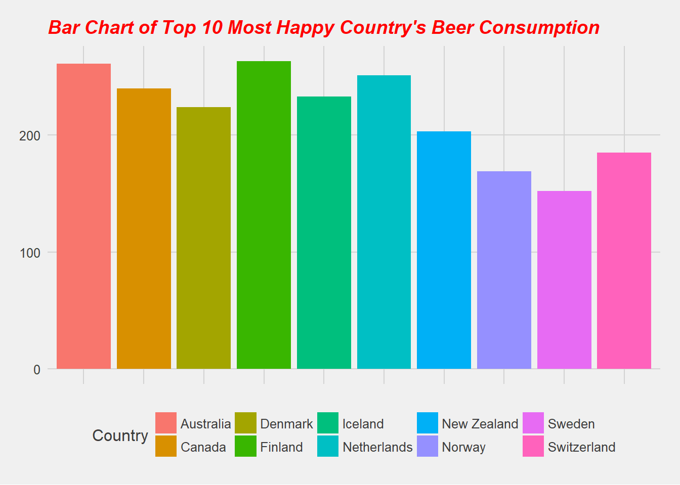
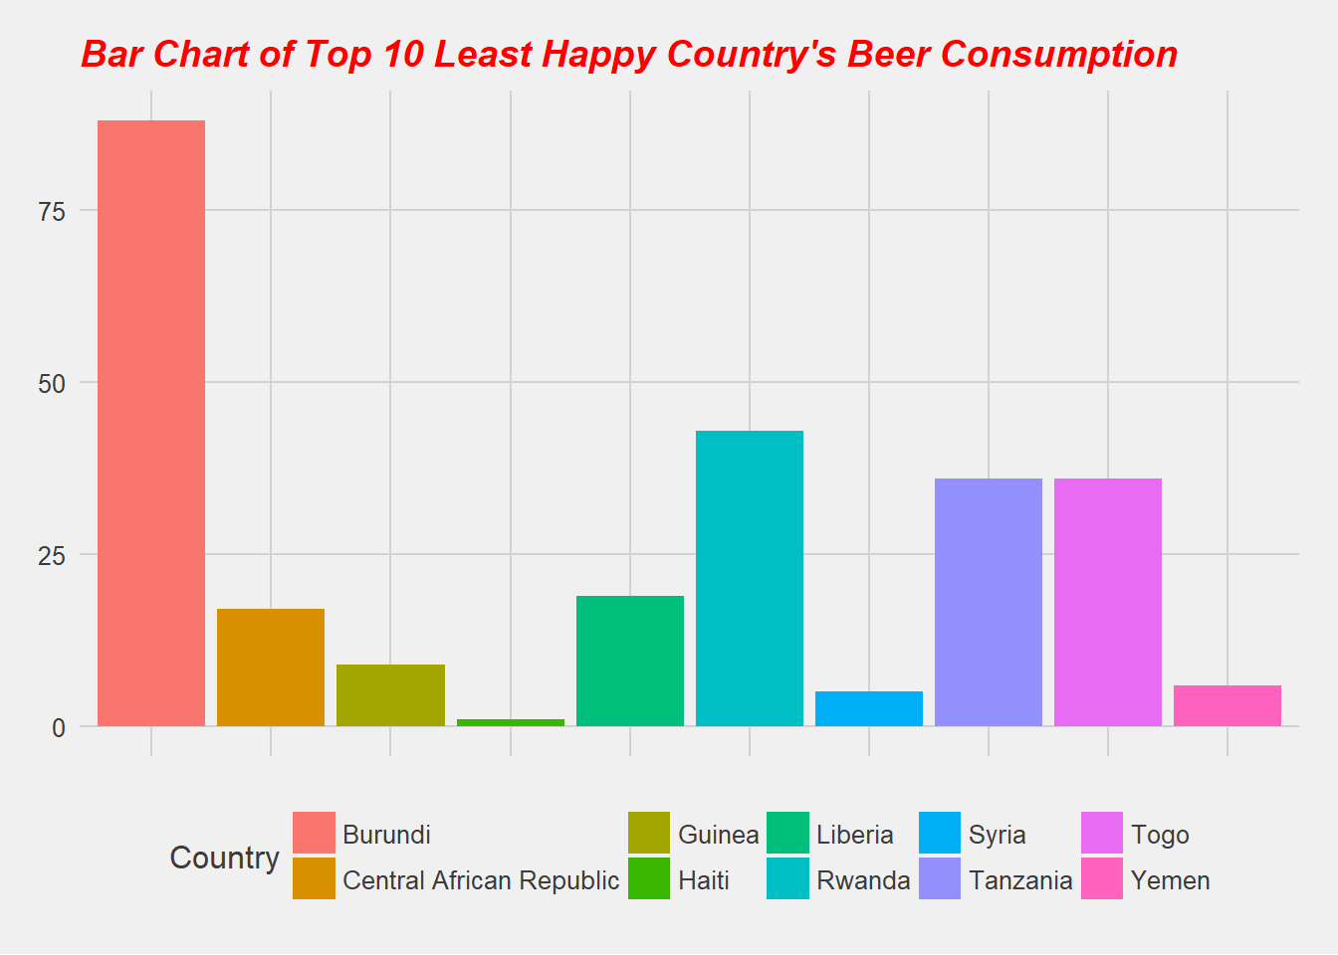
Analysis – Booze vs Happiness
Analysis

Slide 9
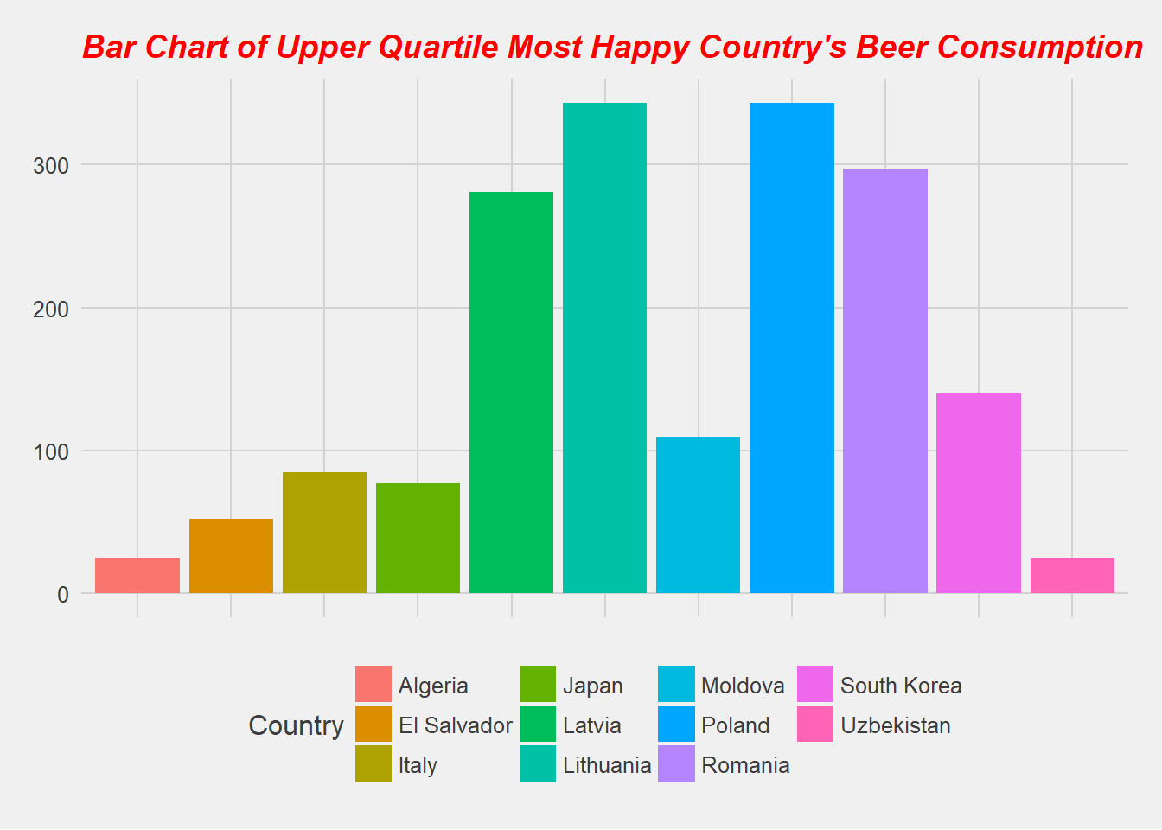
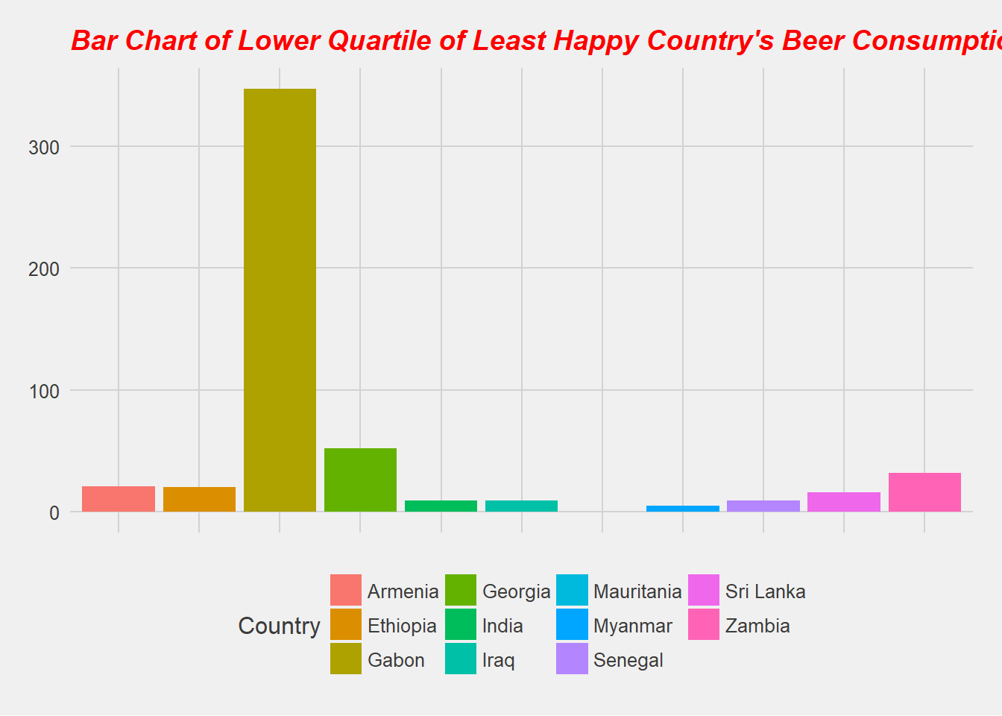
Analysis – Booze vs Happiness
Analysis

Slide 10
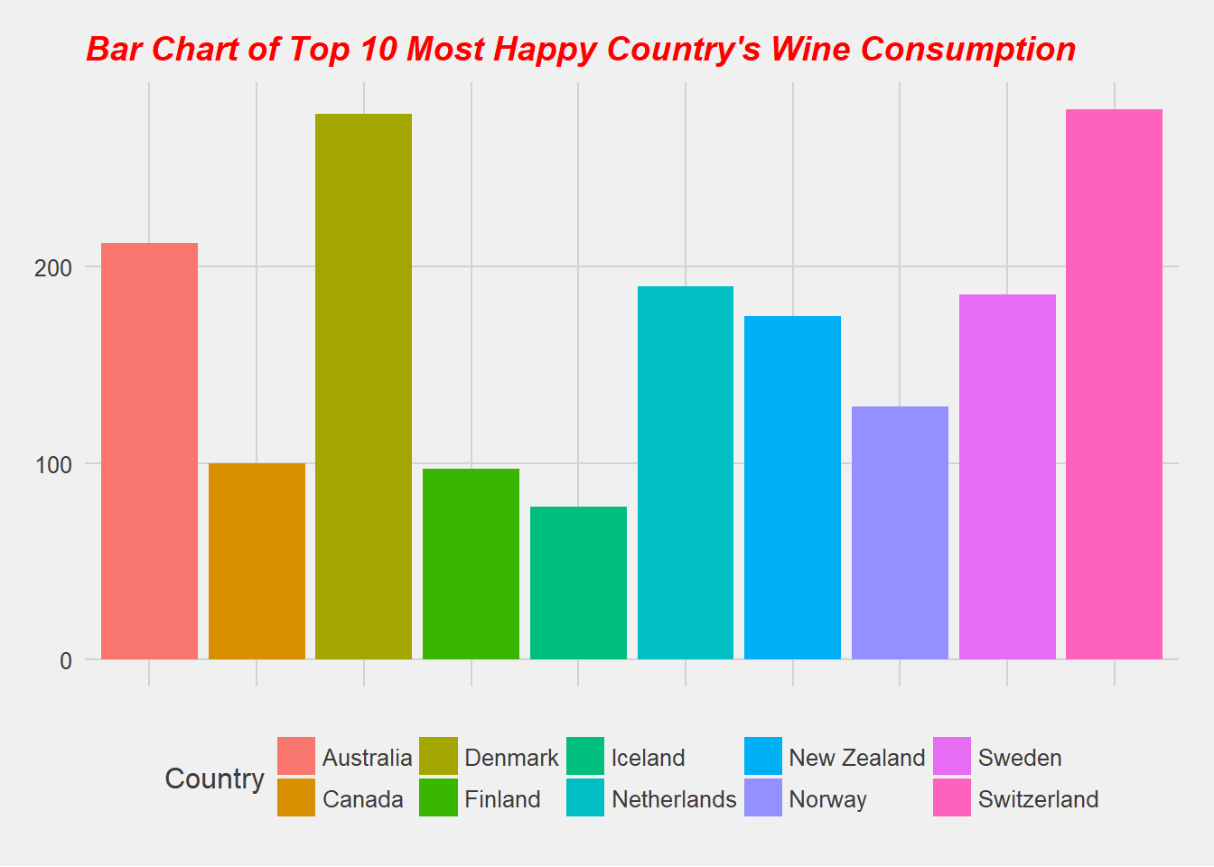
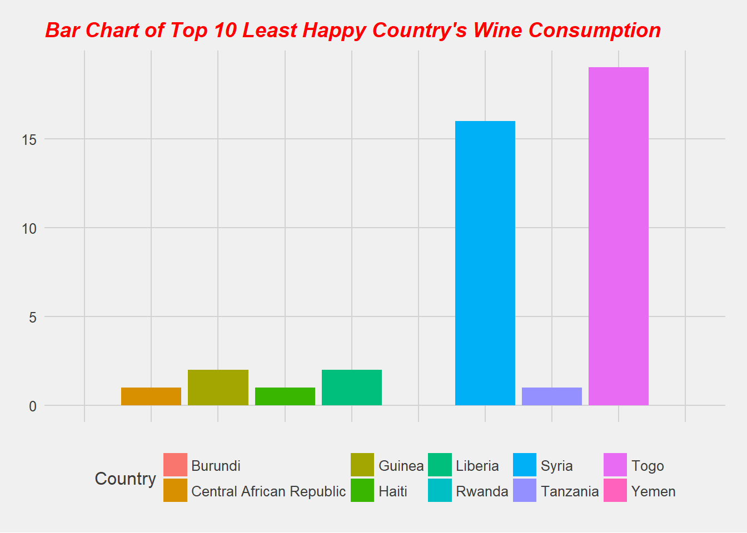
Analysis – Booze vs Happiness
Analysis

Slide 11
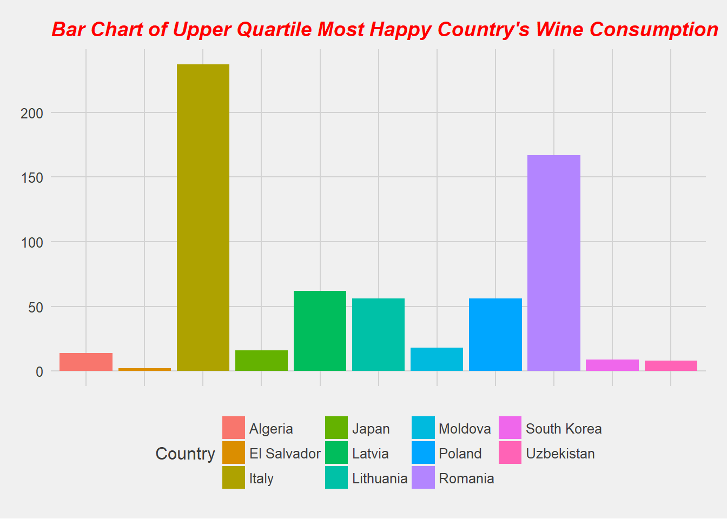
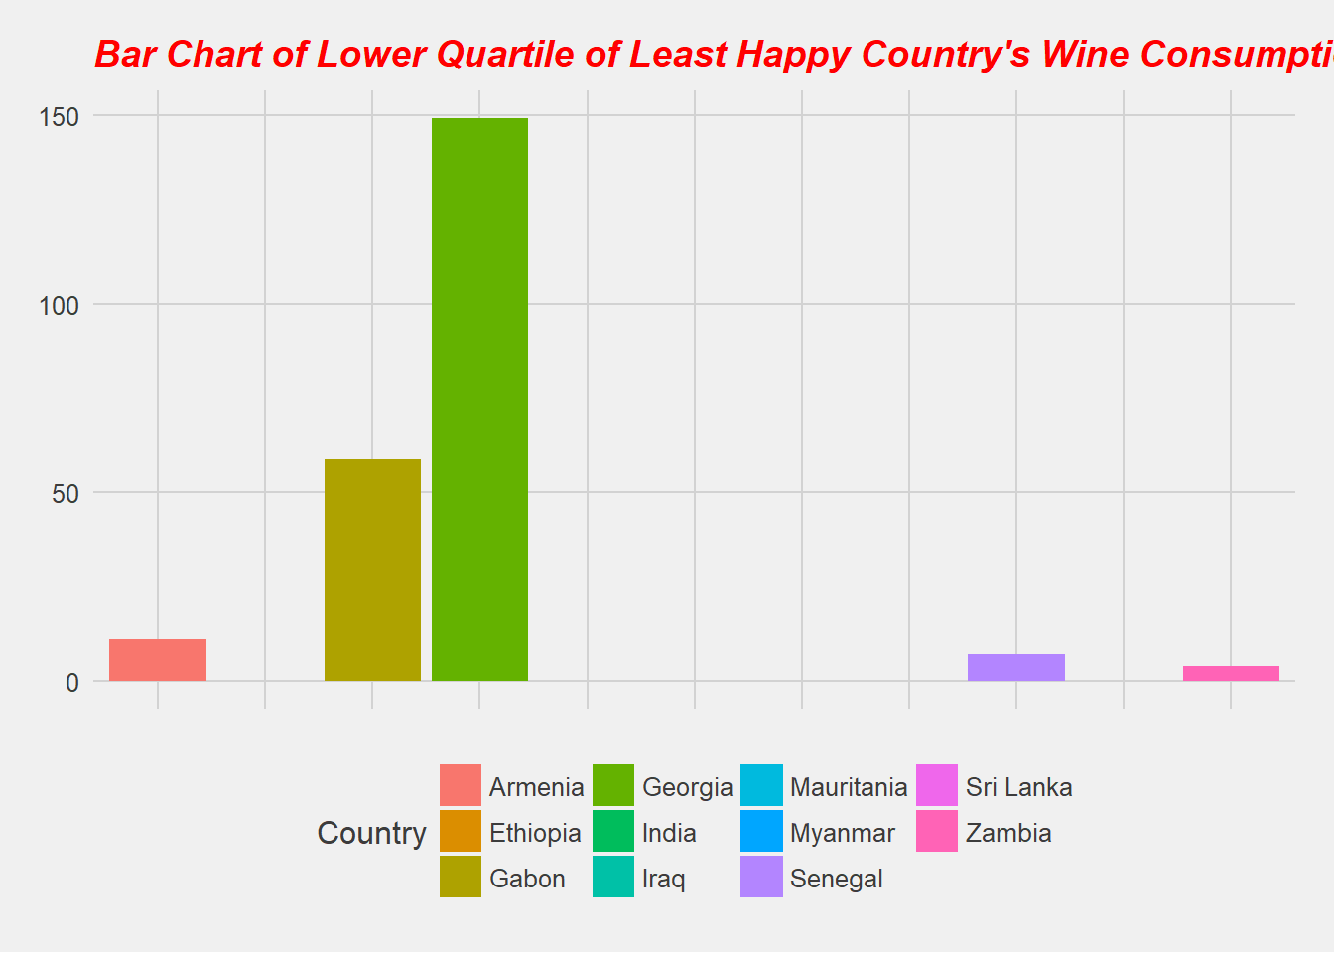
Analysis – Booze vs Happiness
Analysis

Slide 12
Analysis – Booze vs Happiness
Analysis

Slide 13
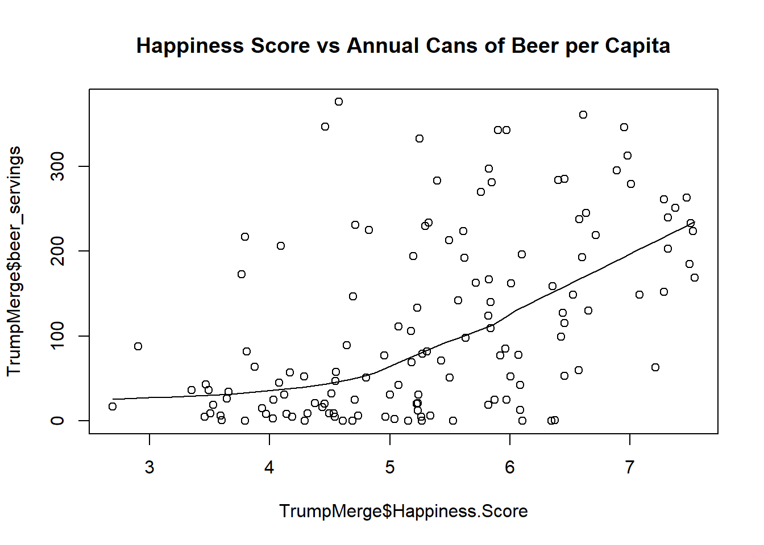
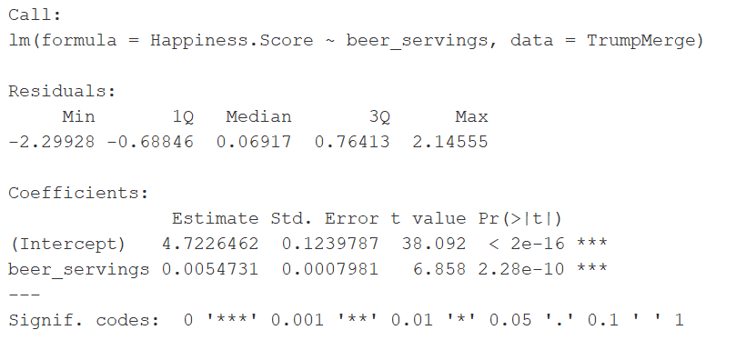
Analysis – Booze vs Happiness

Slide 14
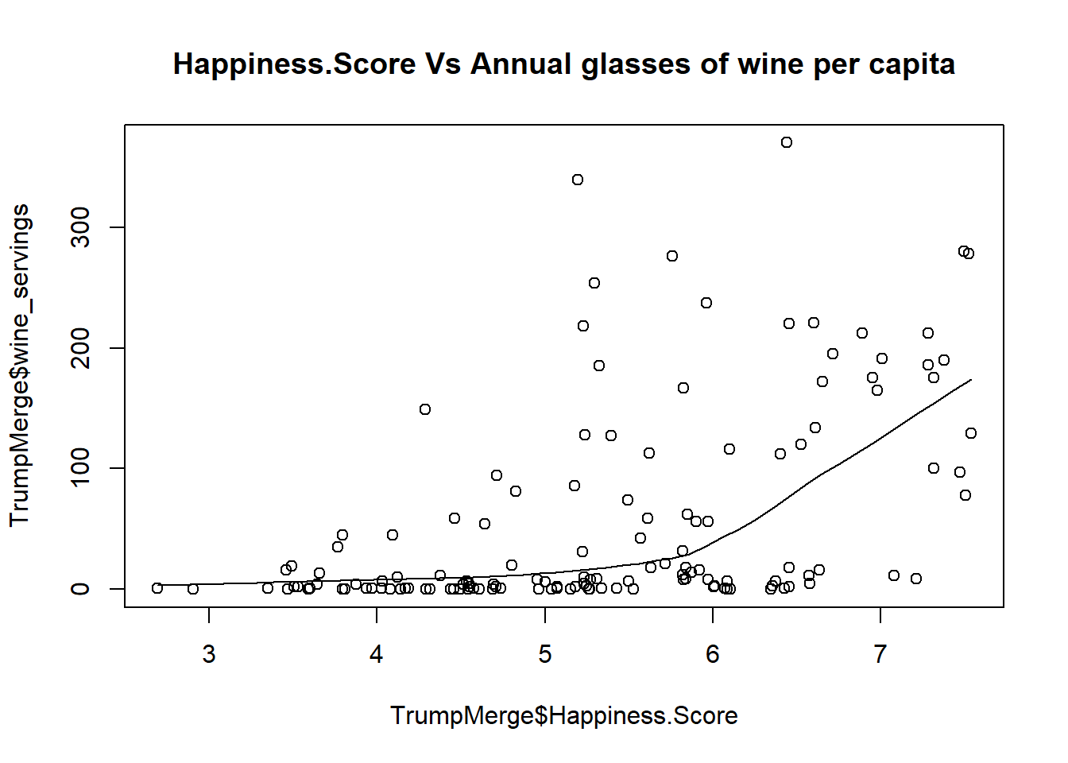
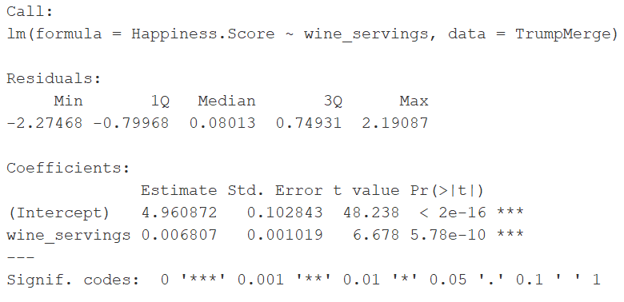
Analysis – Booze vs Happiness

Slide 15
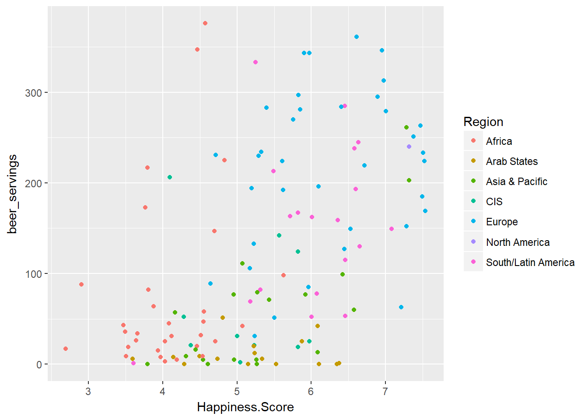
Analysis – Happiness by Region (Beer)

Slide 16
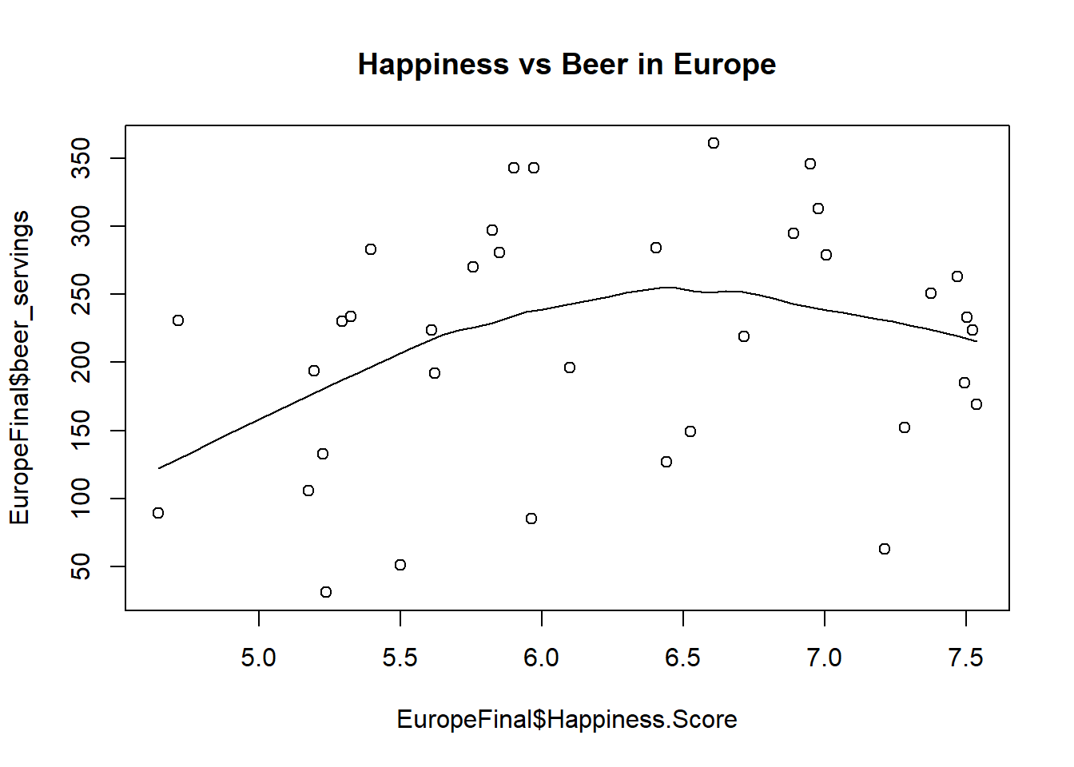
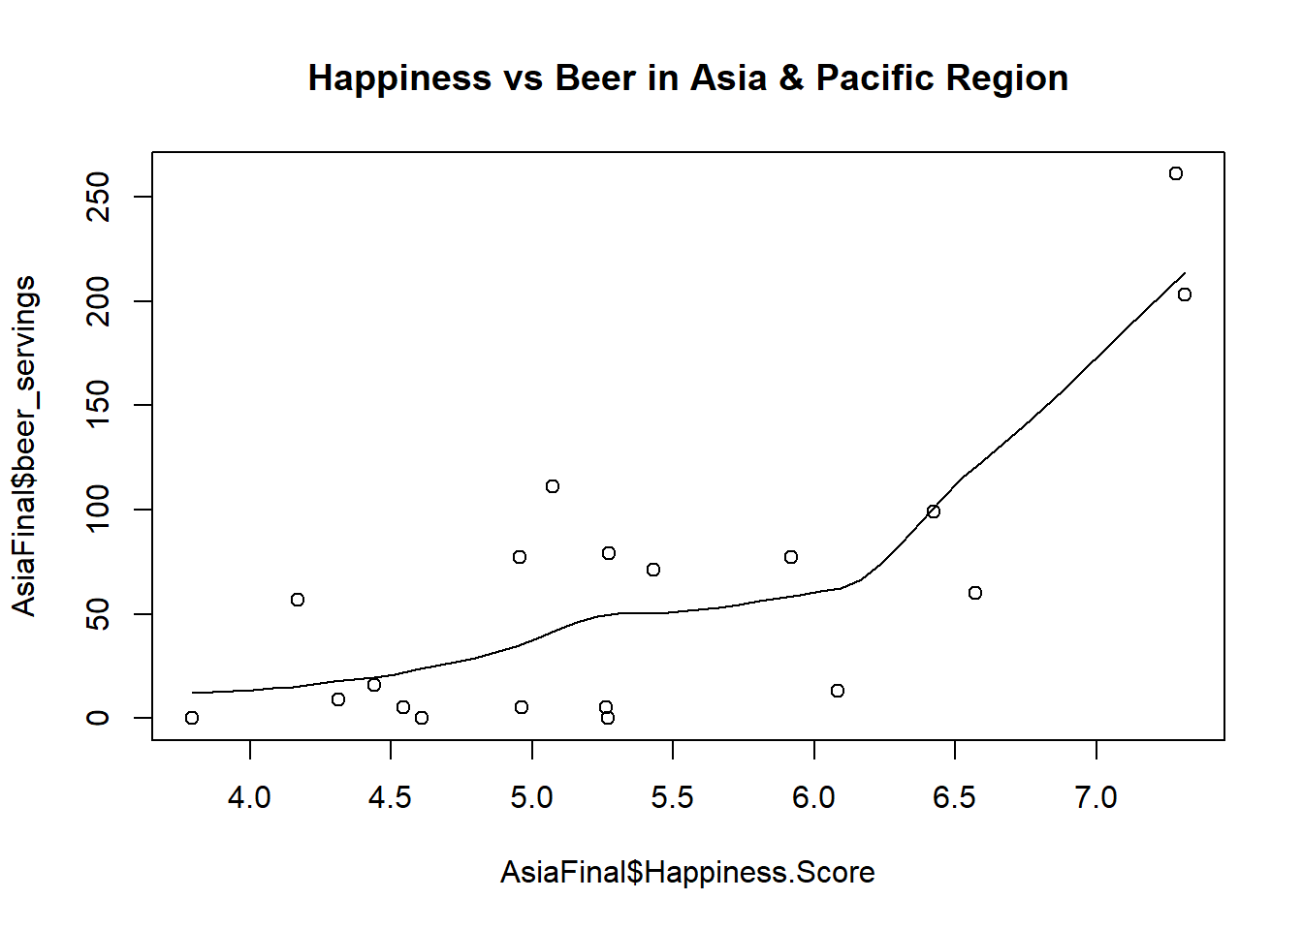
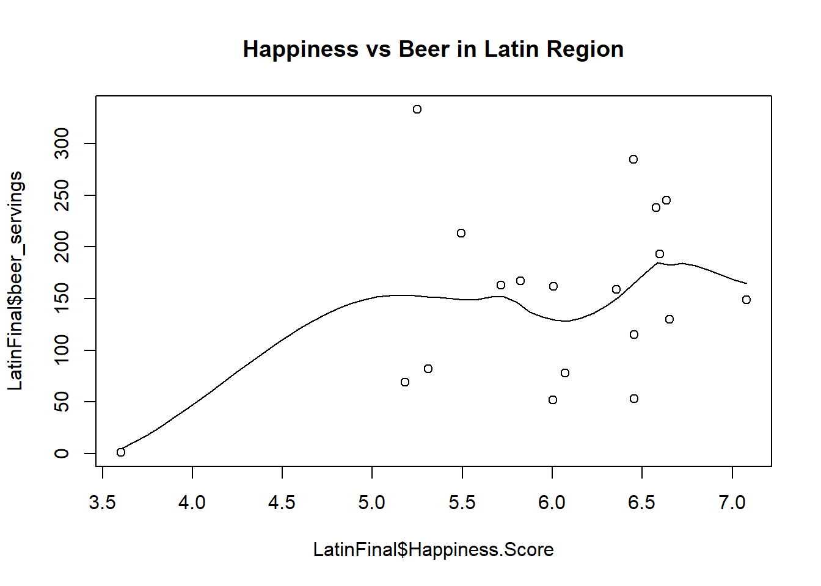
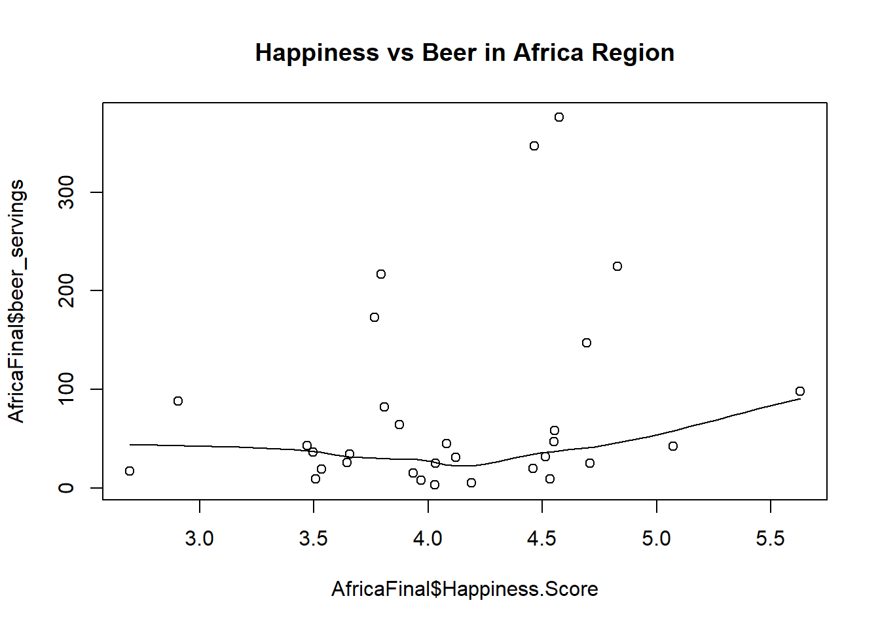
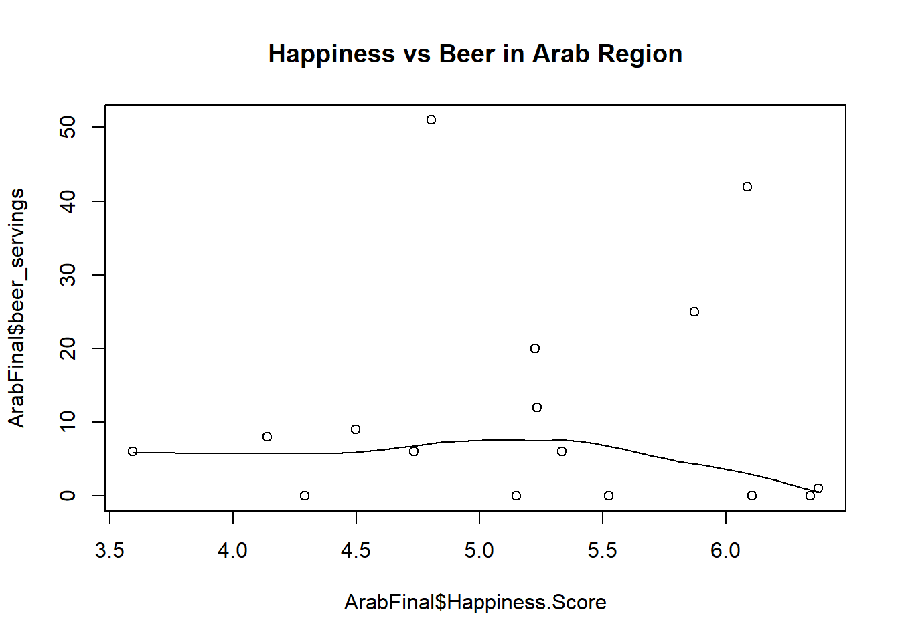
Analysis – Happiness by Region (Beer)

Slide 17
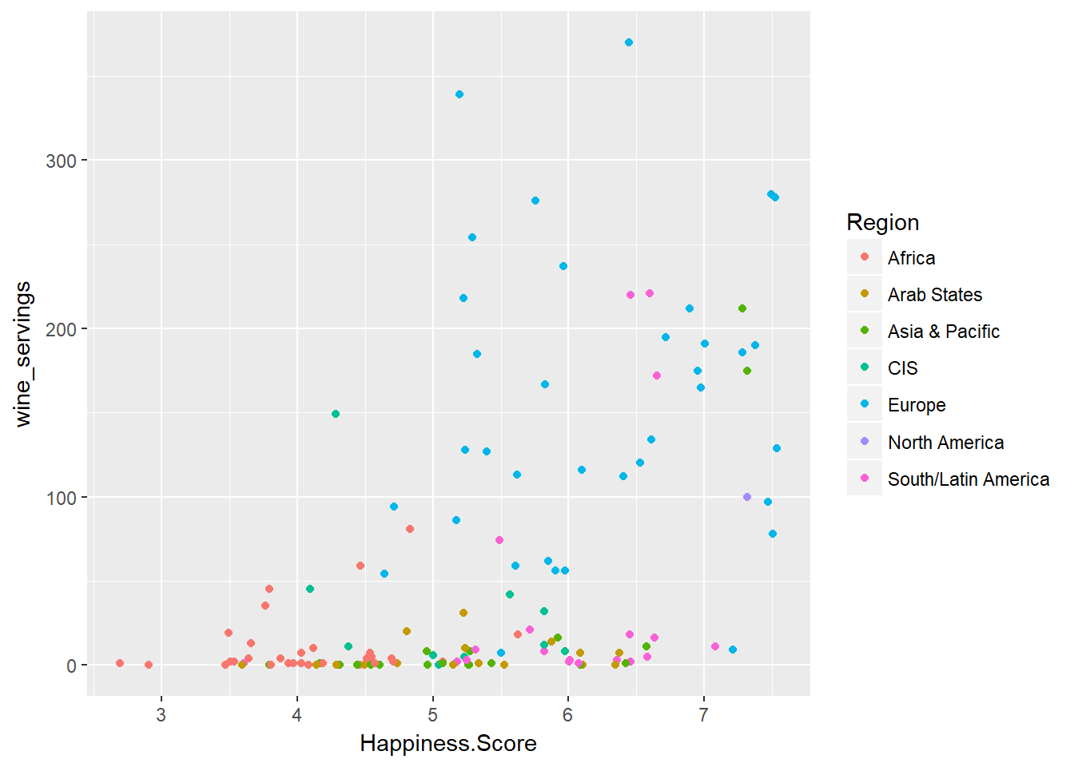
Analysis – Happiness by Region (Wine)

Slide 18
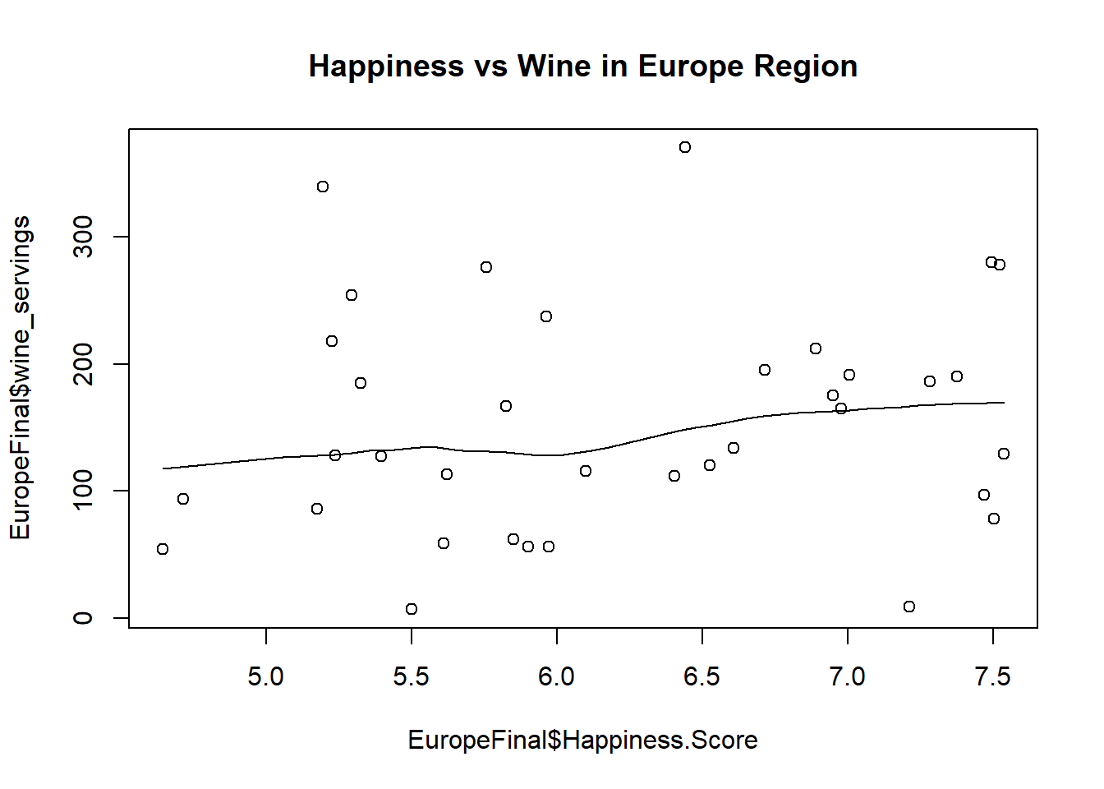
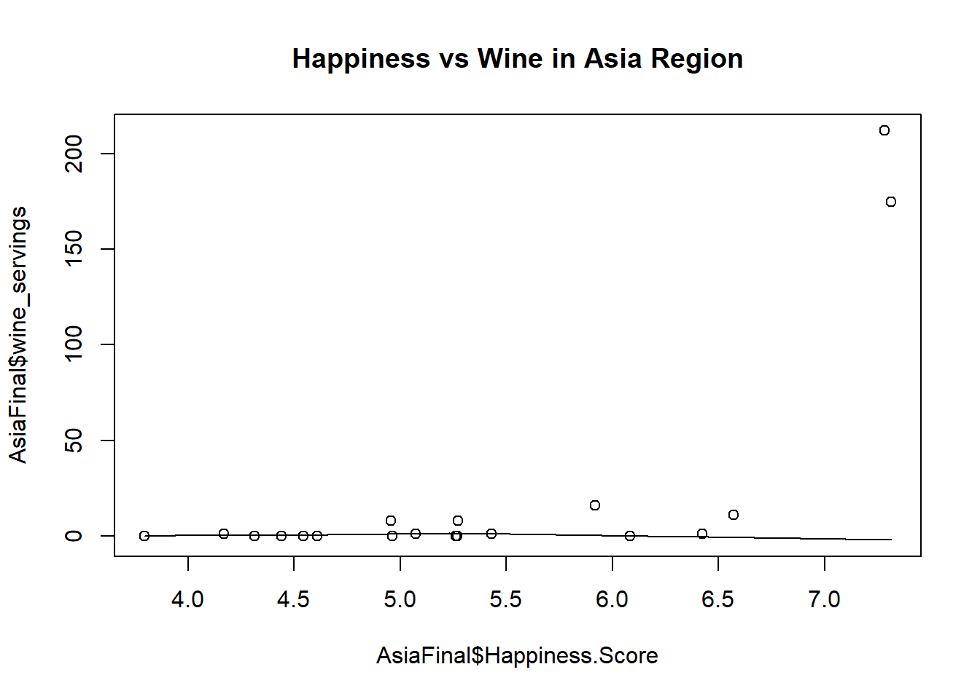
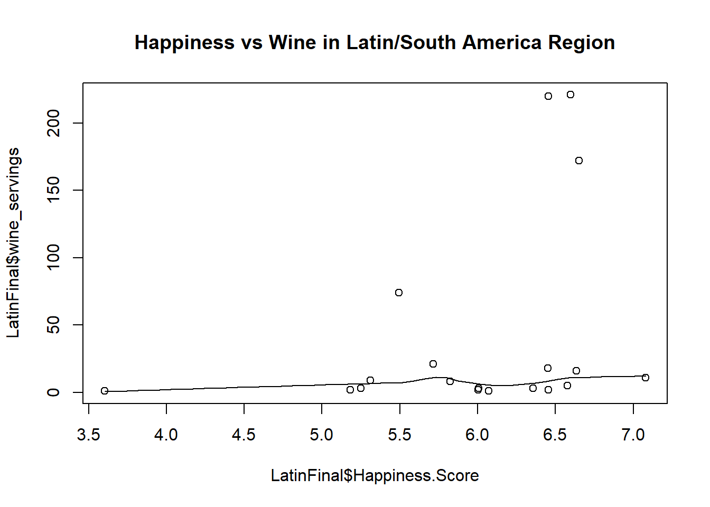
Analysis – Happiness by Region (Wine)

Slide 19
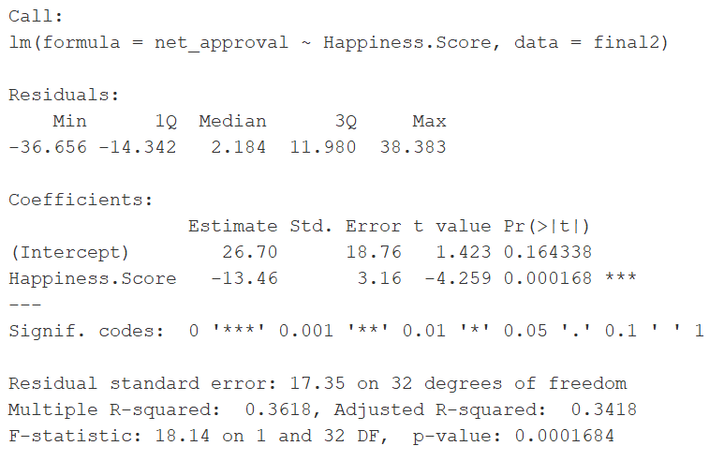
Analysis – Trump & …Happiness

Slide 20
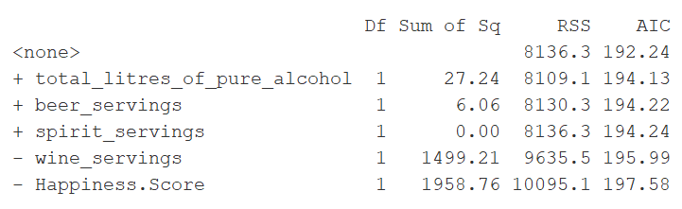
Analysis – Trump & …Happiness w/Booze

Slide 21
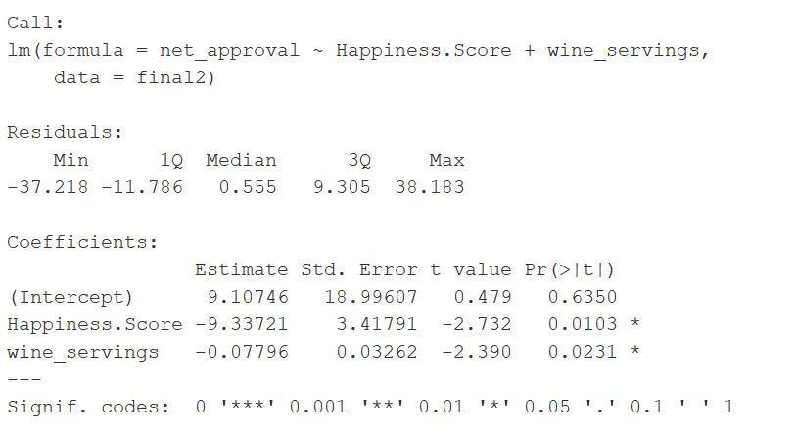
Analysis – Trump & …Happiness w/Booze

Slide 22
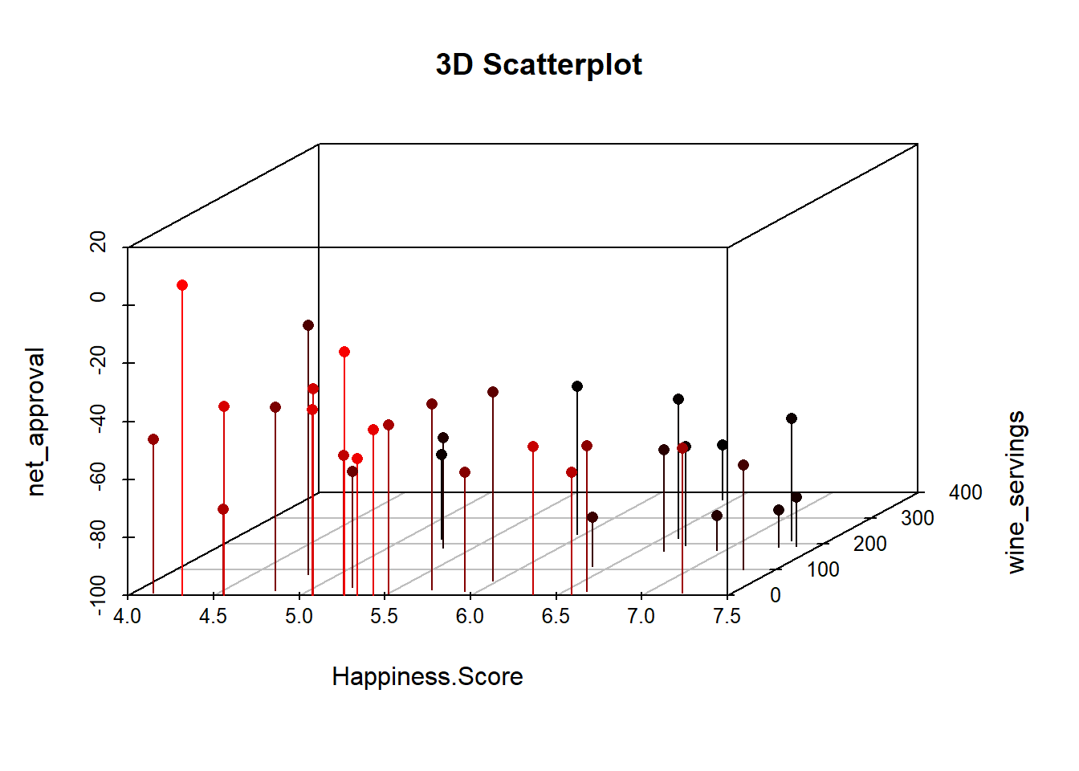
Analysis – Trump & …Happiness w/Booze

Slide 23
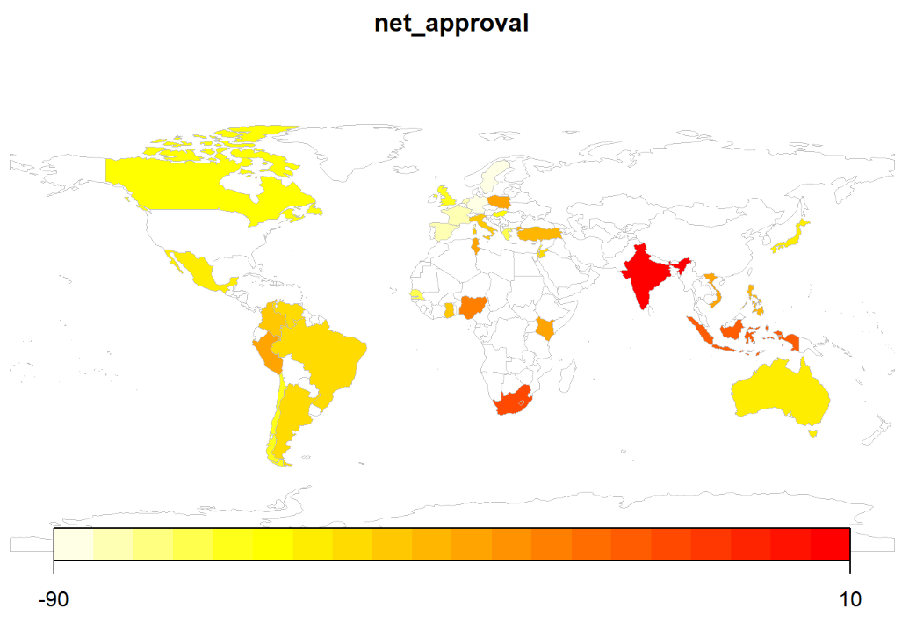

Slide 24

Conclusion
If you’re a country that drinks, you’re happier, and if you so happen to drink wine, you probably don’t approve of Trump’s leadership.

